Slide 1
Computer Science 1
Lecture 2
d.camporaperez@maastrichtuniversity.nl

Slide 2
Variables - Learning Goals
You know the difference between a constant and a variable and know when to use which one
You know how to name, declare, and instantiate variables
You can use variables in your code effectively using operators
You know properties about variables and constants such as data types and scope
You know about casting, how and when to use it. Pitfalls and possible errors.

Slide 3
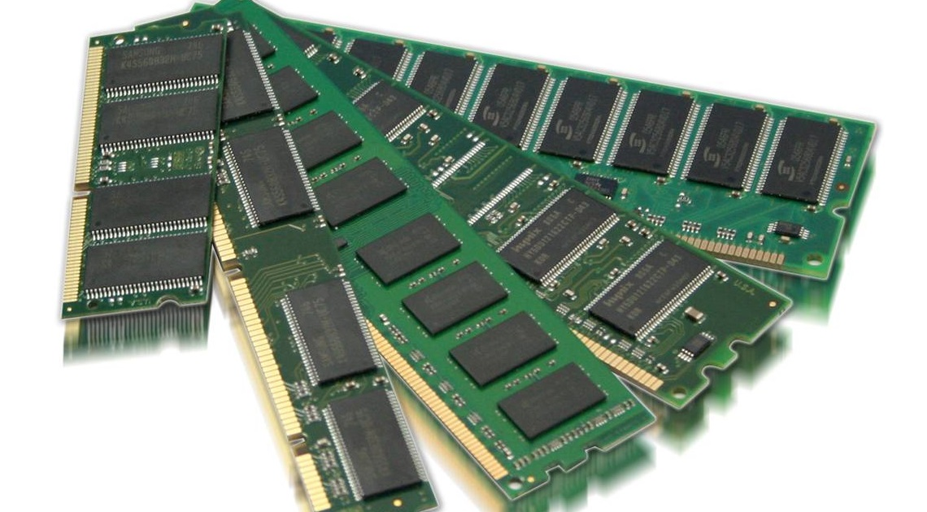
Variables and Values
A variable is a place in memory that we can reference
A value is what a variable can hold
int x = 3;
Data Type
Variable
Value
Assignment operator

Slide 4
Variables - Operators
Operators are operation we can perform on variables and values.
Parentheses ()
Unary operators ++ -- !
Multiplicative operators * / %
Additive operators + -
Relational ordering < > <= >=
Relational equality ==
Logical and &&
Logical or ||
Assignment =
Notes:
Wooclap, what is the difference between = and ==?

Slide 5
Variables - Declaration
To use a variable, you have to declare it. Java naming convention¹: camelCase or PascalCase
datatype variableName,…,variableName;
int i,j,k;
int numberOfStudents;
double temperature, volume, pressure;
String name;
1. https://www.oracle.com/java/technologies/javase/codeconventions-namingconventions.html

Slide 6
Variables - Expressions
Syntactically correct combinations of variables, constants, operators, method invocations and values that evaluate to a single value.
For instance:
b * 3 + c;
!a && (b < 3);
c = Math.pow(a, b) + 5;

Slide 7
Exercise together – What can we print? (2a)
Create a file with a <class name> and .java extension.
Create a public class <class name> inside the file, with a public static void main(String[] args) method.
Use the operation System.out.println() to print: She said "Hello!" to me. 12 + 20 is 32

Slide 8
Variables - Casting
Converting the type of a value of an expression to a new type.
int a = (int)(3.14 * 5); (a is now 15)
double b = 3.14;
int c = (int)(b * 12.3); (b is now 38)

Slide 9
Narrowing and widening data types
We can distinguish between narrowing a datatype: int a = (int)(3.14 * 5);
And widening the datatype: double a = (double)(3 * 5);

Slide 10

Beware of casting – Ariane 5, 1996
On 4 June 1996, the maiden flight of the Ariane 5 launcher ended in a failure. Only about 40 seconds after initiation of the flight sequence, at an altitude of about 3700 m, the launcher veered off its flight path, broke up and exploded.
The failure of the Ariane 501 was caused by the complete loss of guidance and attitude information 37 seconds after start of the main engine ignition sequence (30 seconds after lift-off). This loss of information was due to specification and design errors in the software of the inertial reference system.
The internal SRI software exception was caused during execution of a data conversion from 64-bit floating point to 16-bit signed integer value. The floating point number which was converted had a value greater than what could be represented by a 16-bit signed integer.

Slide 11
Exercise together – Casting exercise (2b)
What are the results of… 11/3 11/3.0 11.0/3.0 (4 == 4.0) && (-5.6 < 0) 'a’+10 "a"+10

Slide 12
Exercise together – Integer limits (2b)
What are the integer limits?
What happens if we try to represent a too big number in an int?
And if we add two numbers surpassing that limit?

Slide 13
Constants
Allows the use of a name for a memory location with a fixed value (i.e. can not be changed by the program). Use to avoid “Magic values”
Use the final keyword e.g. final double BOILING_POINT = 100.0;
Naming guidelines: ALL_CAPITALS

Slide 14
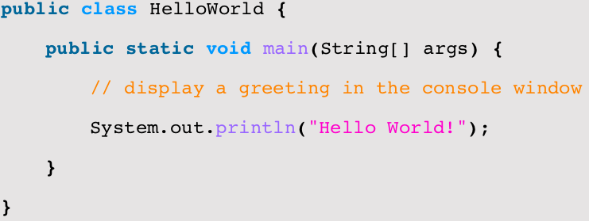

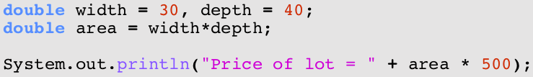
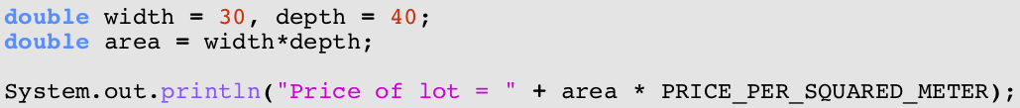
Why use constants?
Magic number

Slide 15
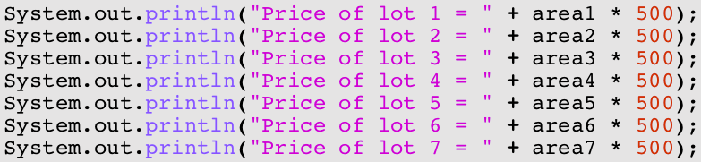
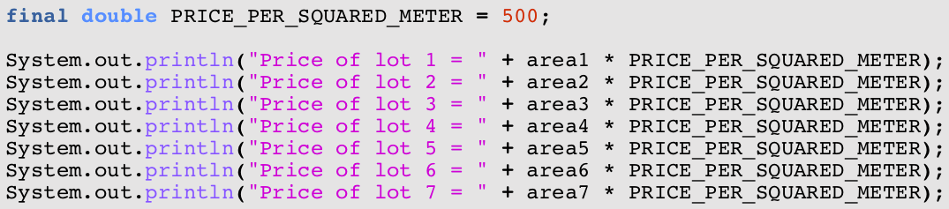
Why use constants? (2)
Check Lecture2c.java before proceeding

Slide 16
Variables - Scope
Local variables are available (“exist”) during the execution of the block in which they are declared.
Blocks are any lines of code that are surrounded by
{
…
}

Slide 17
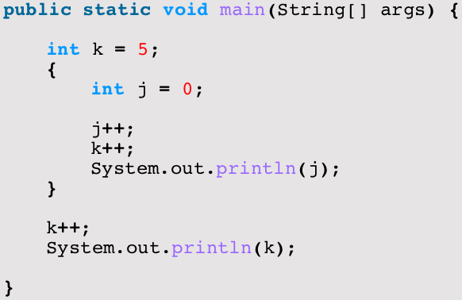
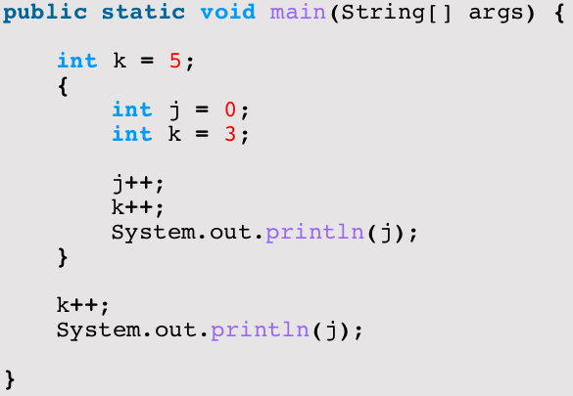

Variables - Scope
j lifetime
compilation
error
k (and args)
lifetime
compilation
error

Slide 18
Variables - Garbage Collection
When a variable’s scope ends, it is still somewhere present in memory (RAM), even though it cannot be accessed anymore.
The Garbage Collector will remove the value from memory for dynamically-allocated values.

Slide 19
Exercise together – How can we extend the lifetime of a variable (2d)
Create one block of code where you calculate the area of a rectangle.
Create another block of code where you print ”The area of rectangle X by Y is Z square meters.”
How can we reuse the variables from the first block in the second block?

Slide 20
Assignment operator
= assigns (stores) the value of an expression (in)to a variable
<variable name> = <expression>;
The variable type has to match the expression type (although type widening is often automatic)
E.g. int width, height;
double area;
width = 5;
height = 3;
area = width * height / 2.0;

Slide 21
Variable instantiation / initialization
= assigning an initial value (during declaration)
e.g. boolean a = true;
int width = 5, height = 3;
boolean result = !a && (height < 5);
double area = width * height / 2.0;
Forgetting to initialize before use will lead to compilation error!
e.g. int x, y;
x = y*y;
leads to:
Tmp.java:8: variable y might not have been initialized x = y*y;

Slide 22
Assignment ≠ Equality
int x;
x = 4;
x = x+1;
x
x
x
4
4
5
Shortcuts:
x++; is same as x = x+1;
x+=3; is same as x = x+3;
also for x--; and x-=3;
4
+1
4
+1
5

Slide 23
Exercise together – Swap values
Let’s write a program where we have two variables (say x which is 5 and y which is 10) and we want to swap their values.
Sounds easy…?

Slide 24
Methods - Learning Goals
You know how to declare methods
You know how to group reusable statements into methods
You know what a parameter is and how to use them
You know how to return values from a method
You know the terminology related to methods

Slide 25
Methods
Groups related statements that re-occur together in a task
Methods have a
name
input called “parameters”
output called “return value”
body

Slide 26
Methods - Declaration
public int sum(int a, int b) {
return a + b;
}
…
int z = obj.sum(1, 5);
Access Modifier
(learnt later)
Return Type
Method name
Parameters
Body
Object
(learnt later)
Method
(call / invocation)

Slide 27
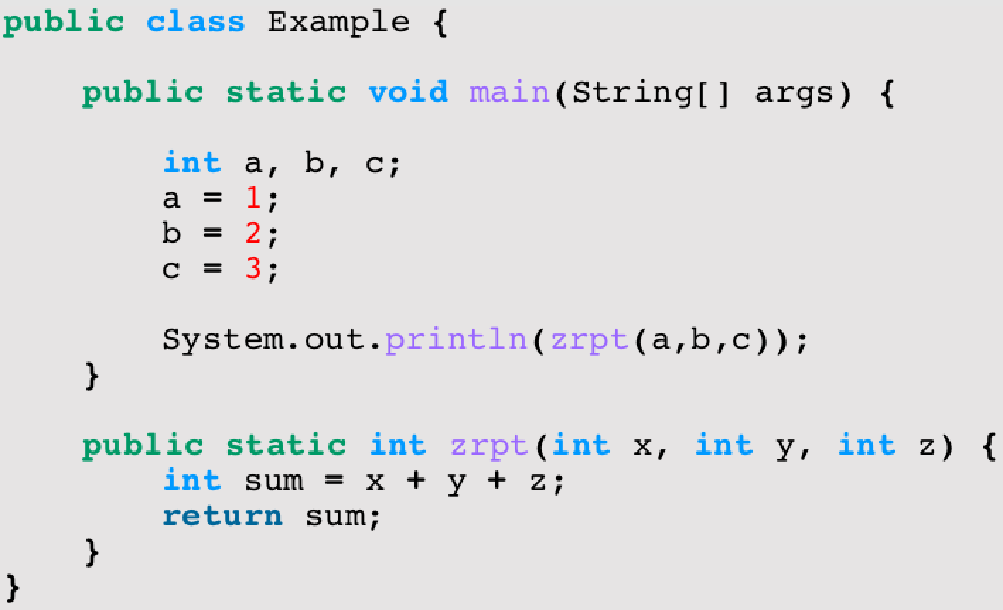
Defining a method
parameters
method name
return type
return statement
Check Lecture2e.java before proceeding

Slide 28
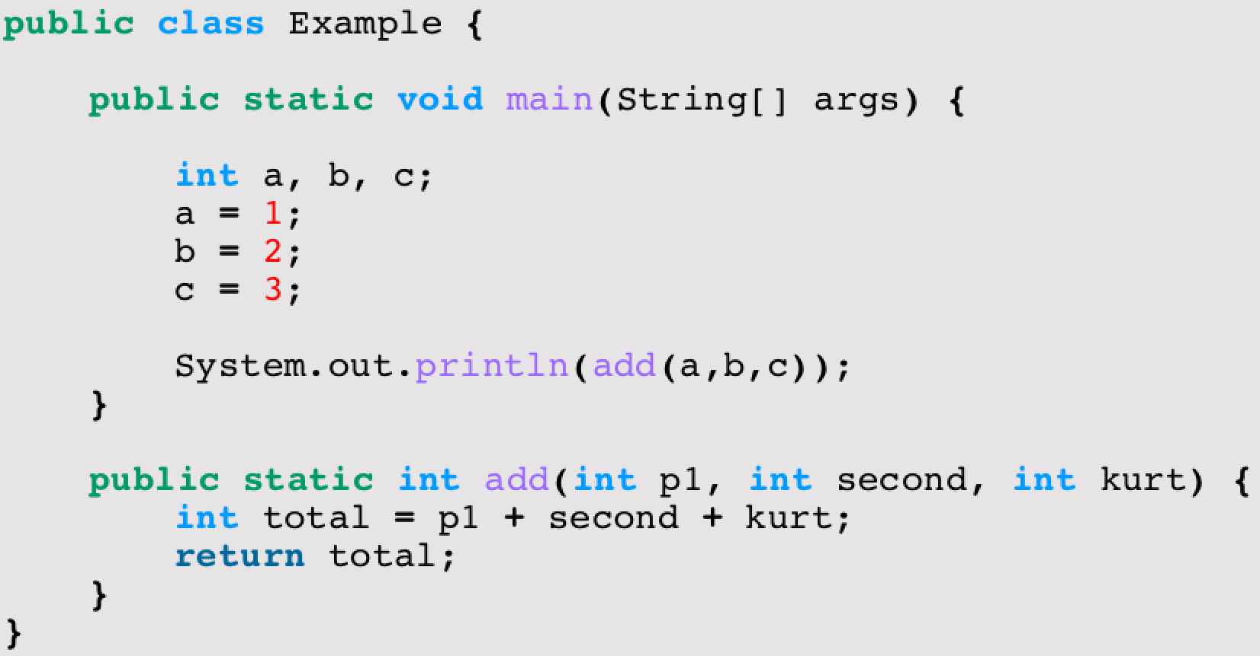
Things Java doesn’t care about… but we might
Method name
Parameter names
Variable names
… as long as they match up!

Slide 29
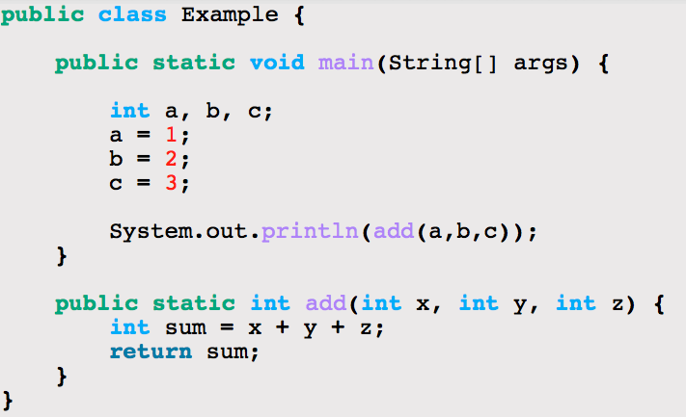
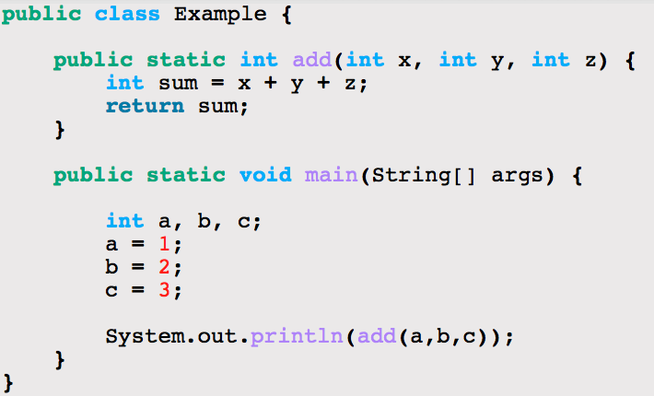
More things Java does not care about
Method order

Slide 30
Methods – Return Statement
return <result_expression>;
Ends the execution of the method and returns a value
Expression type must match return type of method
Mostly (only) occurs as last statement (compiler will complain if it does not)
Special case: return type “void”
meaning: no return type
consequence: no return statement
can still use “return;” to end method execution; often considered bad form

Slide 31
Method – Parameters
(<type1> <name1>, <type2> <name2>, … )
Input the method needs to compute the correct result
comma separated list of variables with their type; declared between parentheses
list can be empty, brackets are still required
lifespan = duration of the method call

Slide 32
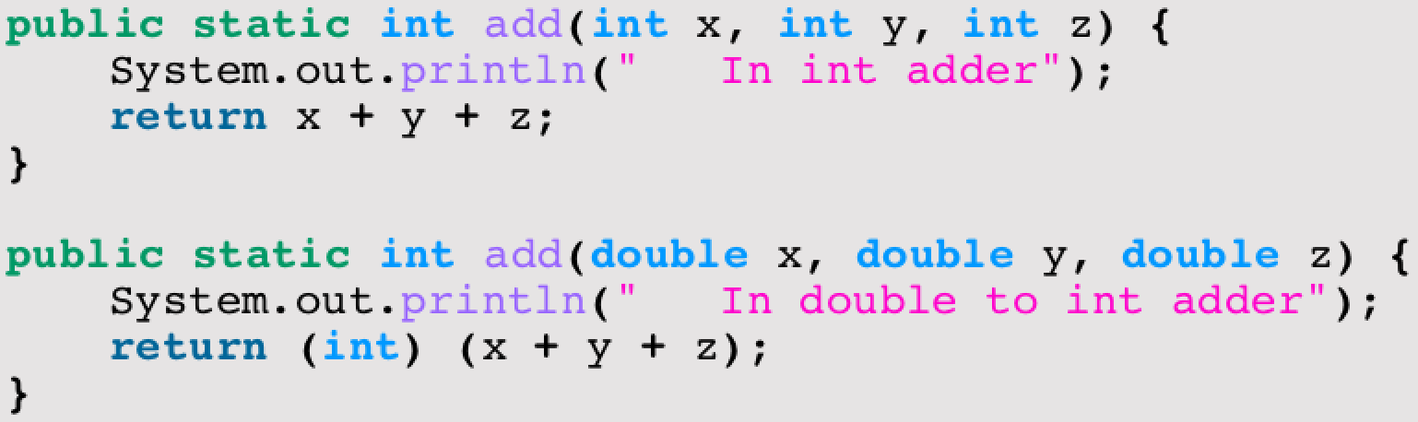
Overloading
In Java, methods are identified by the combination of name and parameter types
Overloading is defining methods with the same name but different parameter counts or types

Slide 33
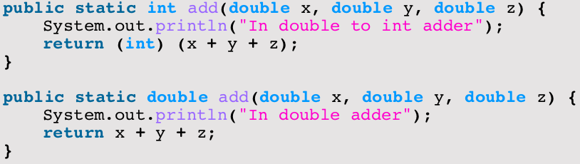
Overloading (2)
The return type of a method is NOT part of its identity!!
Compilation Error!

Slide 34
Calling a method
Calling or invoking a method executes the body of the method and allows collecting the results
factual parameter values have to match the type of the method definition (or be able to become the correct type through widening)
“pass-by-value”: values are copied
collecting the result is done by assigning the method expression to a suited variable

Slide 35
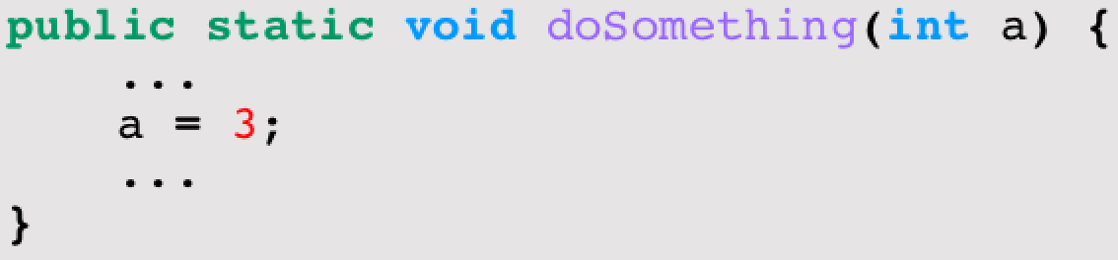
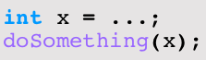
Pass by value
x
…
3
a
…
Check Lecture2f.java before proceeding

Slide 36
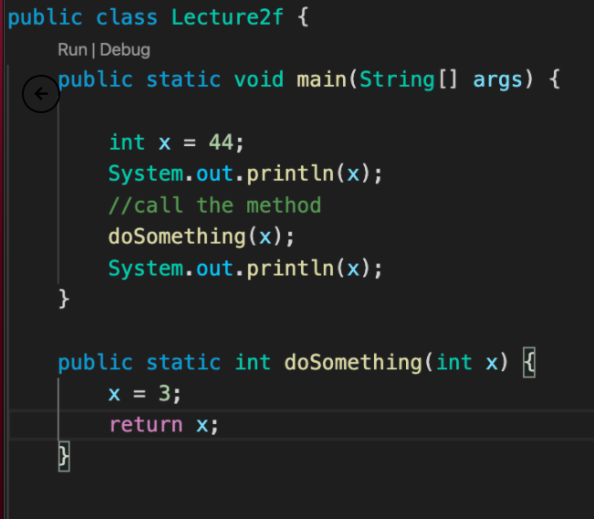
Show of hands
What is printed in the output of this code?
3
44
doSomething
Nothing

Slide 37
Local variables
Additional variables can be defined inside a methods body
lifetime is the execution of the method
(as for parameters)
or the surrounding block as always

Slide 38
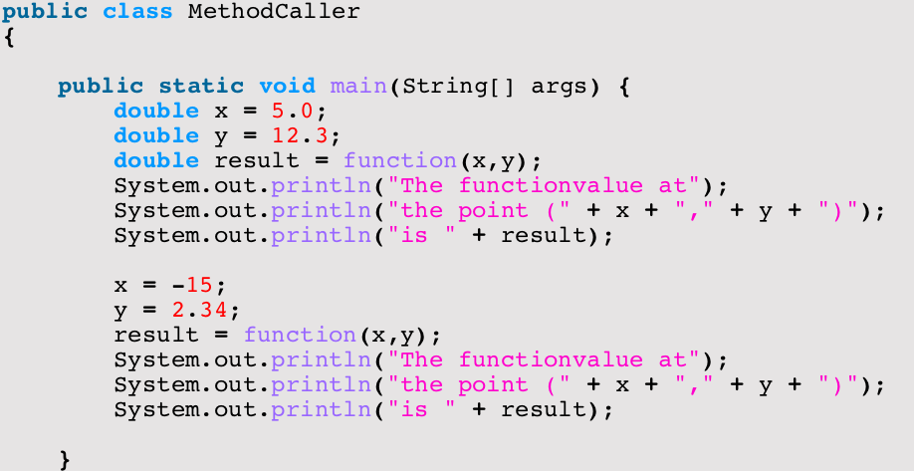
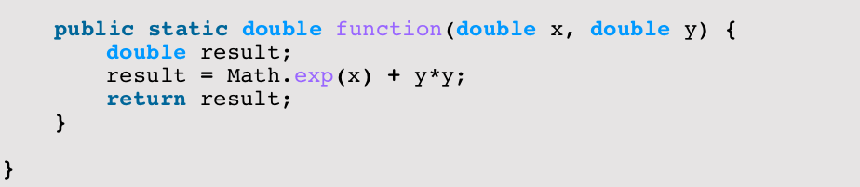
Trouble?
Nope!
Lifespans do not overlap: no connection between the two names!

Slide 39
Control Flow & Variable Scopes
x
y
result
x
y
result
Check MethodCaller.java before proceeding

Slide 40
Math Library
Math.<method>(<parameters>)
E.g. Math.sqrt(x)
Math.min(x,y)
Math.exp(x)
Math.pow(x,y)
Math.cos(x) (radian! – Math.toRadians(x))
Math.round(x)
Look at Java API!!
https://docs.oracle.com/en/java/javase/14/docs/api/java.base/java/lang/Math.html
Check FunWithMath.java before proceeding

Slide 41
Reading input
For most of this course: command line or terminal
In Java 5.0, Scanner was added to read keyboard input
nextInt() reads an int
nextDouble() reads a double
nextLine() reads a line (until <enter>)
next() reads a word (until any white space)
Scanner is not a “library” like Math, but requires instantiation(=declare it, like we do with variables)

Slide 42
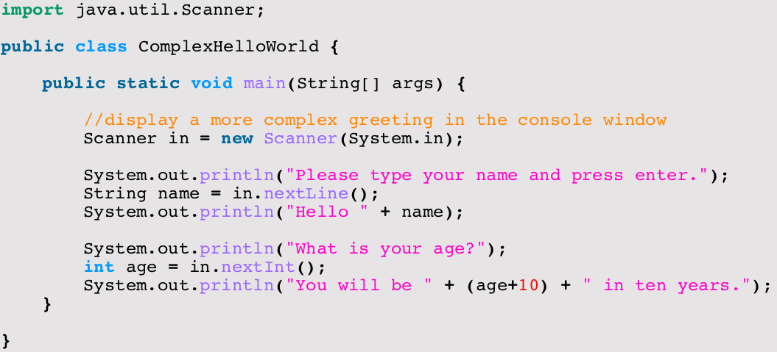
Using Scanner
Check ComplexHelloWorld.java before proceeding

Slide 43
Summary
Variables
declaration, initialization, lifespan
assignment, expressions
Methods
definition and invocation, parameters
Book: Chapters 2 & 5 (check canvas for details)
Quizzes: 1b & 2
Homework: Tasks 1 to 12

Slide 44
The Upcoming Practical
This Friday!
Study the slides, book chapters, quiz 1b and 2, homework before the lab!
On variables and methods
Make sure that you have reached all learning goals after this week.
Learning to program requires knowledge of the basics, on which you can build ever more complex structures.

